Slide 1
ATOMIC ENERGY CENTRAL SCHOOL-03 TARAPUR.
CLASS : IX
SUBJECT : PHYSICS
CHAPTER : 11
“Work & Energy”
MODULE-2/2
Presented By : Ms Soniya Moreshwar Sayam
(PGT-PHYSICS)

Slide 2
Topics to be learn…
Potential Energy.
Potential Energy of an Object at a Height.
Law of Conservation of Energy.
Power
Commercial Unit of Energy.

Slide 3
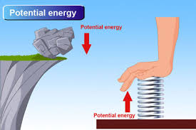
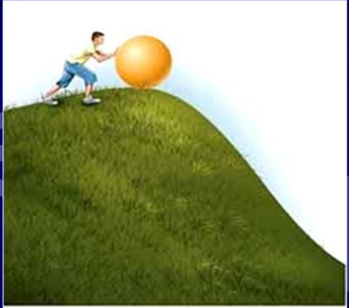
It is the energy possessed by the object due to its position or condition.
It is same as stored energy.
Potential Energy :

Slide 4
Potential Energy of an Object at a Height:
Potential energy of an object at a height is the Gravitational Potential Energy.
The work done in raising an object from the ground to the height against gravity is called as Gravitational Potential Energy.

Slide 5
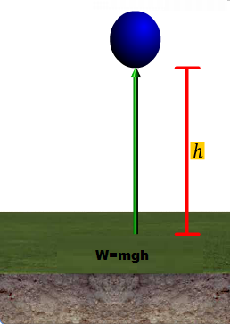
Let an object of mass ‘m’,
Raised through a height ‘h’,
Minimum force required to
raise the object , Weight = mg,
Let the work done on the object
against gravity , ‘W’.
W$=force ×displacement$
$W =mg×$h
W = mgh

Slide 6
By the definition of potential
energy,
PE = Work done
PE= mgh
Gravitational Energy depends
on the initial and final positions
of object and not on the path.

Slide 7
Law of conservation of Energy:
Energy can only be converted from one form to another.
Energy can neither be created not destroyed.
After and before the transformation total energy remains same.

Slide 8
Conservation of Energy : Freely falling body
At position C:
KE = 0
PE = mgh
Total Energy = 0 + mgh = mgh …. (1)
At position B:
Let $v_{1}$be velocity of body, then u = 0, S = x.
From equation : $v^{2}=u^{2}$+2 a S
$v_{1}^{2 }$= 0 + 2 g x = 2gx
$Since KE= \frac{1}{2}mv^{2}$=$\frac{1}{2}mv_{1}^{2}$ =$\frac{1}{2}m×$ 2gx
And PE = mg(h-x) = mgh – mgx
$∴Total Energy=mgx+mgh −mgx=mgh$….(2)
u = 0
u = 0
u = 0
u = 0
C
x
x
$$v_{1}$$
$$v_{1}$$
$$v_{1}$$
$$v_{1}$$
B
h
h
v
v
v
v
A
Ground level

Slide 9
Conservation of Energy : Freely falling body
At position A:
Let velocity of body be v, then u = 0, S = h.
From equation : $v^{2}=u^{2}$+2 a S
$v^{2}=0$+ 2 g h = 2 g h
$Since KE= \frac{1}{2}mv^{2}=\frac{1}{2}m ×$ 2 g h =mgh
And PE = 0
Therefore, Total Energy = mgh + 0 = mgh ….(3)
“During free fall of an object, the decrease in
potential energy, at any point in its path, appears as
an equal amount of increase in kinetic energy.”
u = 0
u = 0
u = 0
u = 0
u = 0
u = 0
C
x
x
$$v_{1}$$
$$v_{1}$$
$$v_{1}$$
$$v_{1}$$
$$v_{1}$$
$$v_{1}$$
B
h
h
v
v
v
v
v
A
Ground level

Slide 10
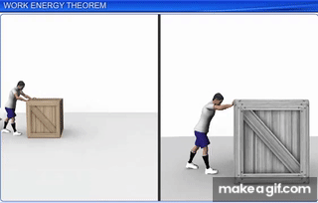
Rate of Doing Work: Example
Stronger person
may do certain
Work in relatively
less time.

Slide 11
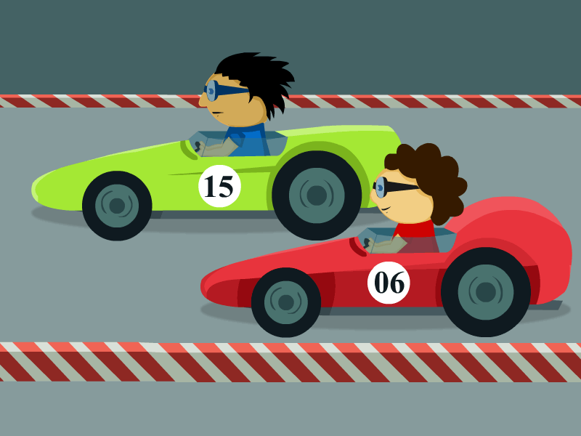
Rate of Doing Work: Example
A more powerful
vehicle would
complete the
journey in shorter
time than a less
powerful one.

Slide 12
Power
Definition: “Power is defined as the rate of doing work.”
Let an agent does a work ‘W’,
Takes time ‘t’,
Then Power ‘P’, Power = $\frac{Work }{time}$
P = $\frac{W }{t}$

Slide 13
SI unit of power is watt (W).
Definition: “1 watt is the power of an agent, which does work at the rate of 1 joule per second.”
1 watt = $\frac{1 joule }{1 second}$=> 1 W = $\frac{1J }{1s}$
Larger rates of energy transferred expressed in kilowatts (kW)
Average Power = $\frac{Total Energy Consumed }{Total Time Taken}$

Slide 14
Commercial unit of energy:
One kilowatt hour (kWh) is a bigger unit of energy.
Definition : “One kilowatt hour is the energy used in one hour at the rate of 1000 joule per second.”
1 kWh = 1 kW ×1 h
= 1000 W ×3600 s
= 3600000J
1kWh = 3.6 ×${10}^{6}$ J

Slide 16
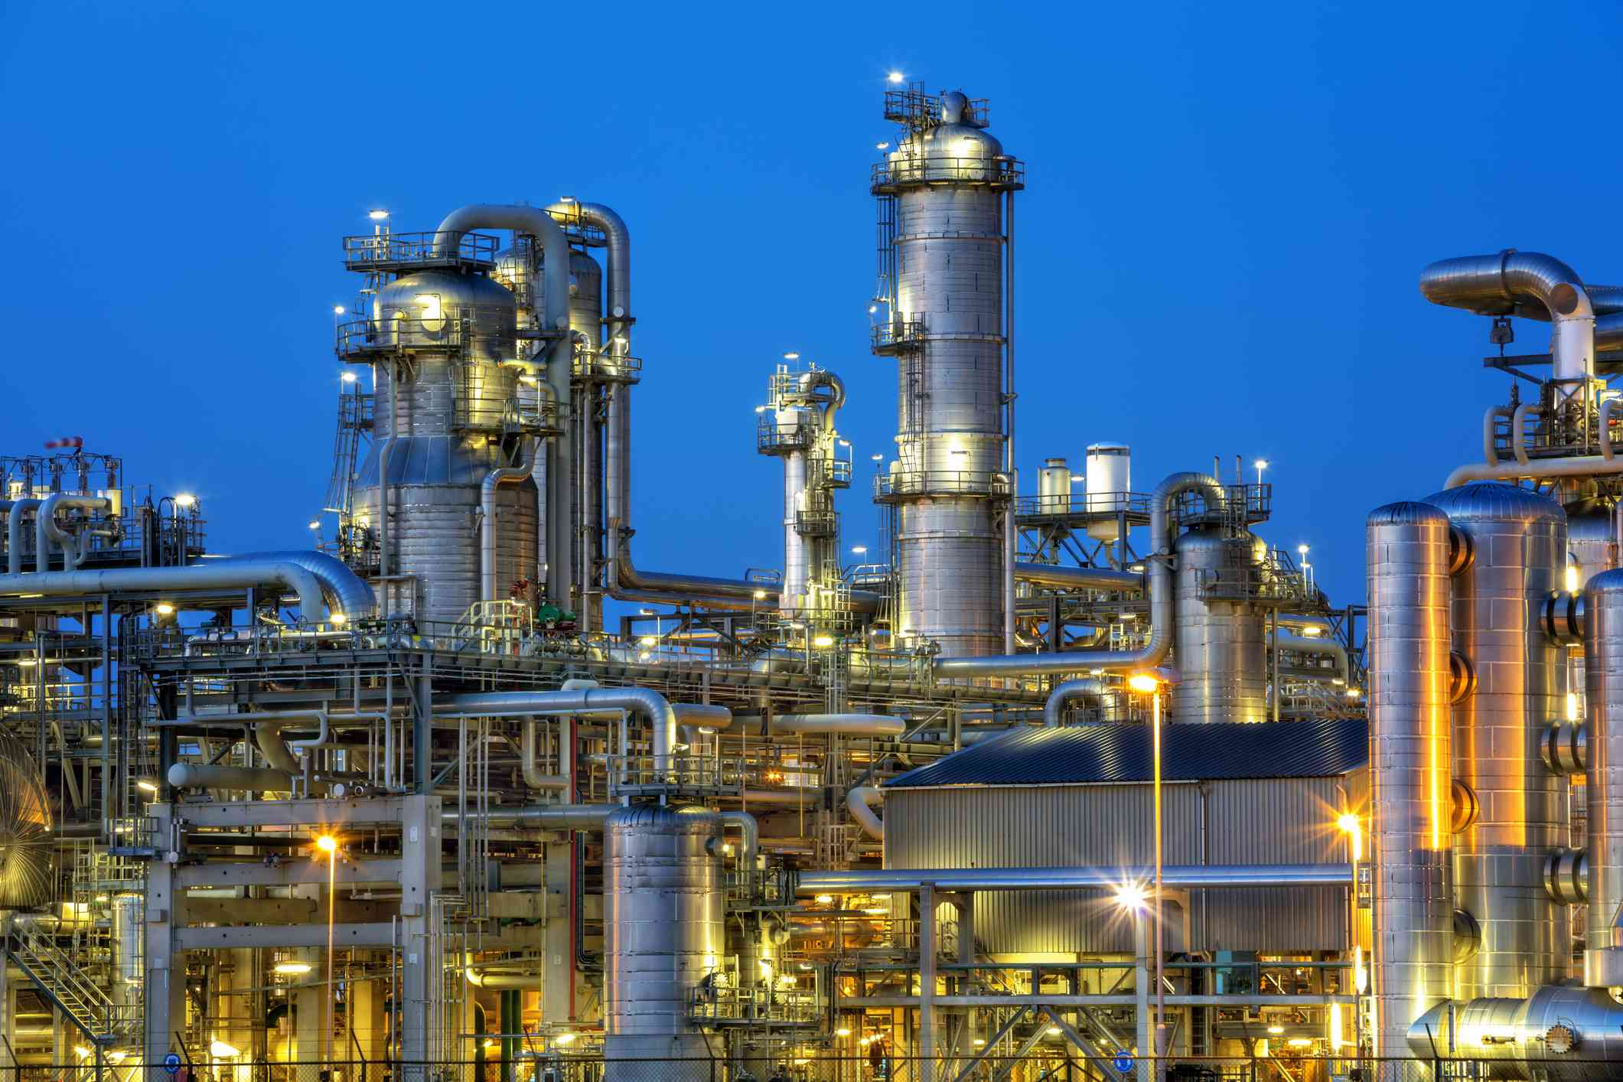
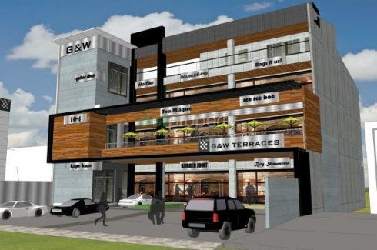
Industries Commercial establishments

Slide 17
Electrical energy used
during a month is
expressed in terms
of ‘units’.
1 unit = 1 kilowatt hour.

Slide 18
Thank You!

